Slide 1

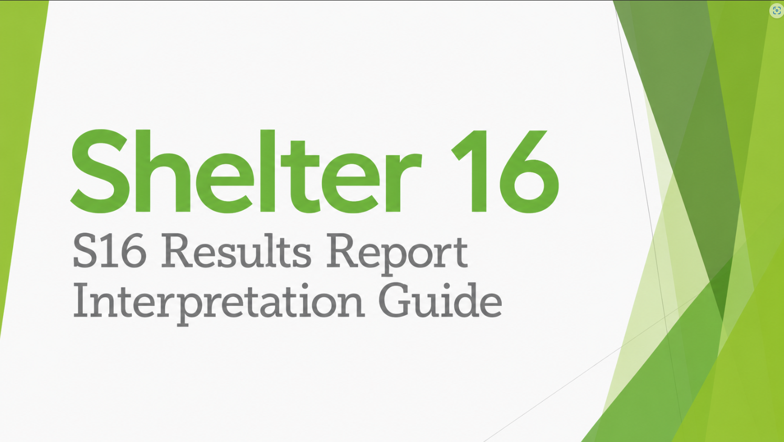

University of North Carolina at Charlotte
Organizational Science
Notes:
Welcome to the Shelter 16 Results Report Interpretation Guide.
The purpose of this presentation is to help you understand what each part of your S16 report means and, more importantly, how to use the information. We will start with the broad summary on the first page, work through the demographic and question-level results, and then discuss how to turn the findings into practical next steps.
The goal is not to become an expert in survey statistics. The goal is to feel comfortable reading the report, identifying the results that deserve the most attention, and deciding where your organization should focus its energy.

Slide 2
How to Use This Guide
The S16 Results Report is designed to help leaders move from information to focused action.
1
Check participation
Start with headcount, surveys completed, and response rate.
2
Review demographics
Use employment status and tenure to understand who is represented.
3
Interpret engagement
Read the overall Engagement Index and the four engagement items.
4
Interpret satisfaction
Identify problem, opportunity, and strength areas.
5
Choose action steps
Use the Best Practices Guide to prioritize feasible improvements.
Notes:
The report is easiest to understand when we move through it from the broadest information to the most specific.
First, we will look at participation. Before interpreting any scores, we need to know how many employees responded and how much of the organization is represented.
Next, we will review the demographic information. This helps us understand whether the responses include employees with different employment statuses and levels of tenure.
We will then examine engagement. This includes the overall Engagement Index and the four questions used to calculate it.
After that, we will move into the satisfaction results. These questions help us identify the specific parts of the employee experience that are going well and the parts that may need improvement.
Finally, we will use the Best Practices Recommendation Guide to move from results to action.
One important idea to keep in mind throughout the presentation is that we should interpret the numbers in context. We are not looking for one isolated score that tells us everything. We are looking for patterns that can help us select a small number of meaningful next steps.

Slide 3
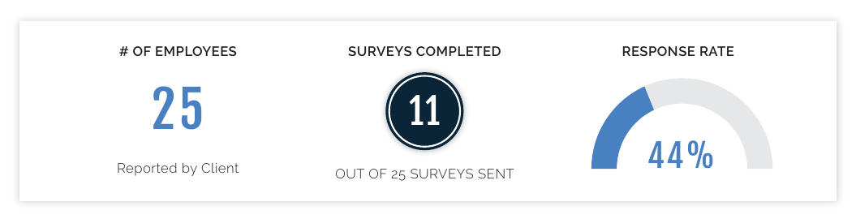
Participation Snapshot
How much of the organization is represented in the results?
What each metric means
What is an ideal response rate?
Ideally, at least 70% of staff will respond to the survey.
A higher proportion of staff responding makes it more likely that different roles, schedules, employment types, and levels of experience are represented.
The more employees who participate, the more confident we can be that the results reflect the organization as a whole
(not just the employees who felt especially positive or negative)!
70% is a goal, not a magic number! Results below 70% can still be useful, but they should be interpreted more cautiously because some employee perspectives may be missing.
▪
# of Employees: the organizational headcount reported by the client.
▪
# of Surveys Completed: the number of employees who submitted usable responses.
▪
Response Rate: the percentage of invited employees who completed the survey.
Notes:
The first thing we want to look at is how many employees are represented in the report.
The total number of employees is the organizational headcount that was provided before the survey was launched. The number of surveys completed tells us how many employees submitted usable responses. The response rate is the percentage of invited employees who completed the survey.
For example, the sample report shows that the organization had 25 employees and received 11 completed surveys. That produces a response rate of 44 percent.
Ideally, we aim for a response rate of at least 70 percent. The reason is fairly straightforward: the more employees who respond, the more confident we can be that the results reflect the organization as a whole rather than only a small group of employees.
A higher response rate also makes it more likely that we are hearing from people with different jobs, schedules, employment statuses, and levels of experience. This is especially important in a smaller shelter, where just a few missing responses can noticeably change the percentages.
Seventy percent is a goal, not a magical cutoff. A response rate below 70 percent does not mean that the results are useless. It simply means that we need to be more cautious about assuming that the respondents speak for everyone.
When the response rate is lower, it is helpful to ask who may be missing. For example, were overnight employees less likely to respond? Were part-time employees harder to reach? Did one department participate more heavily than another?
Those questions help us understand how much confidence to place in the findings and how broadly we should generalize them.

Slide 4
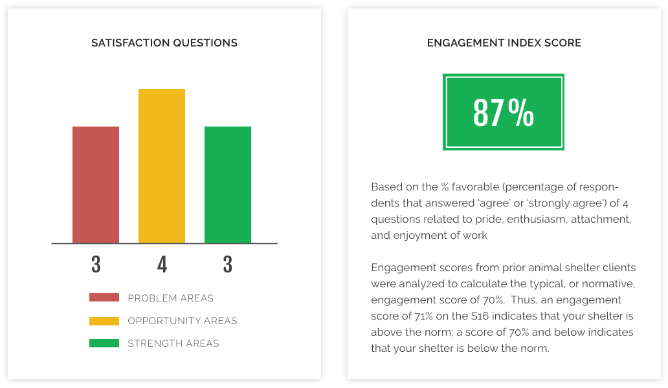
Start by Viewing Your Results Broadly
Identify broad strengths and areas needing attention.
Satisfaction Question Summary
Problem Areas are questions with less than 60% favorable responses. These are the lowest-rated parts of the employee experience and should receive the most immediate attention.
Growth Areas are questions with 60–79% favorable responses. These areas are not necessarily serious problems, but employees’ experiences could be more consistently positive.
Strength Areas are questions with 80% or more favorable responses. These are areas employees generally view positively. Celebrate what is working and continue the practices supporting these results.
Engagement Index Score
▪
The Engagement Index is based on employees’ pride, enthusiasm, attachment, and enjoyment of work.
▪
This represents the average percent favorable across the four engagement questions.
▪
In the S16 report, 71% or higher is above the animal shelter norm.
Notes:
When reviewing your results, it might be helpful to start with a quick summary of the two major parts of the survey: satisfaction and engagement.
On the satisfaction side, the colored bars show how many questions were classified as problem areas, opportunity areas, or strength areas.
Red represents problem areas. Questions with less than 60% favorable responses. These are the lowest-rated parts of the employee experience and should receive the most immediate attention.
Yellow represents opportunity areas, which may also be described as growth areas. Questions with 60–79% favorable responses. These results are not necessarily severe problems, but they show places where the employee experience could be strengthened.
Green represents strength areas. Questions with 80% or more favorable responses. These are areas that employees rated positively and that the organization should work to maintain.
It is important not to focus only on the red results. Green results tell us what the organization is already doing well. Those practices may be worth protecting, reinforcing, or even applying to lower-rated areas.
Next, the Engagement Index Score provides an overall picture of employees’ connection to their work and organization. It is based on four questions addressing pride, enthusiasm, attachment, and enjoyment of work.
The score is the average percentage of favorable responses across those four questions. In the S16 report, a score of 71 percent or higher is above the animal shelter norm. A score of 70 percent or lower is below that norm.
This score is a useful starting point, but it does not tell us exactly why engagement is high or low. To understand that, we need to look at the individual engagement questions and the satisfaction results later in the report.

Slide 5
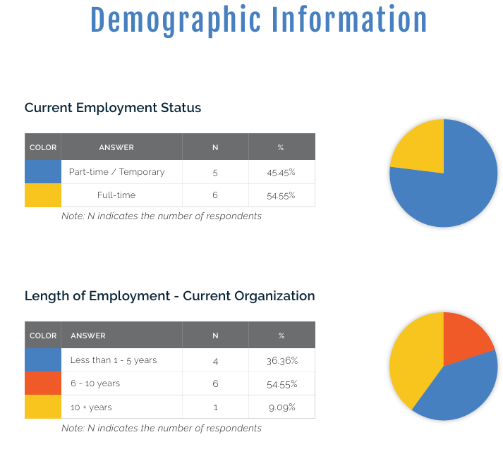
Reviewing Demographic Data
Demographics help you understand whose experiences are reflected in the report
What to look for
Current Employment Status
Are full-time, part-time, and temporary employees represented?
▪
Length of Employment
Are newer and longer-tenured employees both represented?
▪
N tells you how many respondents are in each group.
Percentages show their share of completed surveys.
▪
Notes:
The demographic section helps us understand who participated in the survey.
The first table shows current employment status. In the example, we can see how many respondents were full-time and how many were part-time or temporary.
The second table shows how long respondents have worked for the organization. This allows us to see whether the results include newer employees, longer-tenured employees, or a combination of both.
The letter N means the number of respondents in each category. The percentage tells us what portion of all completed surveys came from that group.
We are not using this information to identify individual employees. In fact, the results should always be reviewed in a way that protects anonymity.
Instead, demographics help us judge representation. For example, if most employees are part-time but nearly all respondents were full-time, the report may not fully capture the part-time employee experience.
Likewise, newer employees and longer-tenured employees may experience the organization differently. A report dominated by only one group may provide a narrower picture.
The main question to ask is: do the people who responded reasonably reflect the employees whose experiences we need to understand?
Because S16 reports present overall organizational results rather than separate scores for each demographic group, these tables provide context. They do not tell us that a particular group caused a certain result.

Slide 6
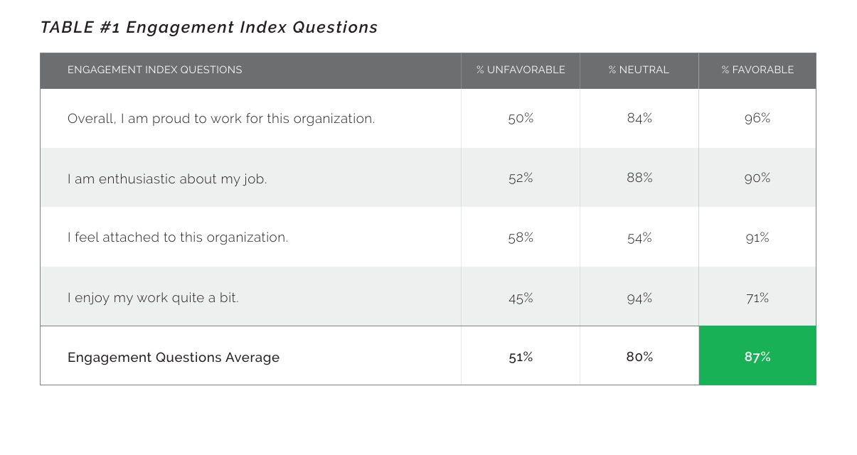
Engagement Question-Level Results
The Engagement Table shows the four items that make up the overall Engagement Index.
How to read the Engagement Table
▪
Each row corresponds to one engagement question
▪
Each column represents the percentage of staff who responded as unfavorable, neutral, and favorable for that question
▪
The final row combines all four questions and provides the overall engagement average.
Green = 71%+ favorable
▪
The green or yellow box corresponds to the overall Engagement Index Score
Yellow = 70% or lower
Engagement tends to improve when satisfaction areas such as communication, teamwork, leadership, training, and resources improve!
Notes:
Let’s discuss engage question-level results more closely.
Engagement Index into the four individual questions that make up the overall score.
Each row represents one aspect of engagement: pride in the organization, enthusiasm for the job, attachment to the organization, and enjoyment of the work.
The final row combines the four questions and shows the overall Engagement Index average. This is the same overall score that appeared on the first page.
The color of the final score helps with interpretation. Green means that the favorable score is 71 percent or higher and is therefore above the animal shelter norm. Yellow means the score is 70 percent or lower and is below the norm.
The overall score is helpful, but we should also compare the four individual questions. Employees might be very proud to work for the organization, for example, while feeling less enthusiastic about their daily jobs. Those are related but different experiences.
The lowest engagement item can give us a clue about the type of connection that may need strengthening.
It is also important to remember that engagement often develops from the conditions captured by the satisfaction questions. Improvements in communication, leadership, teamwork, training, autonomy, procedures, and resources can ultimately help improve overall engagement.

Slide 7
Interpreting Engagement Response Results
For engagement, response categories reflect employees’ connection to their work and organization.
% Favorable
% Neutral
% Unfavorable
Employees are positively connected to the organization and their work. High favorable scores indicate pride, enthusiasm, attachment, and enjoyment.
Employees are not clearly positive or negative. High neutral scores can signal uncertainty, mixed experiences, or an opportunity to strengthen engagement.
Employees may feel disconnected, less proud, less enthusiastic, or less attached. High unfavorable scores require closer attention.
What we should we look for with engagement scores:
▪
Which engagement question/area is lowest?
▪
Are neutral responses high enough to suggest uncertainty?
▪
Are unfavorable responses concentrated on one item or spread across all four?
▪
Do satisfaction results explain why engagement is high or low?
Notes:
The engagement table divides responses into favorable, neutral, and unfavorable percentages.
A favorable response means that employees answered positively to the statement. Within the engagement section, a high favorable score suggests that employees feel proud, enthusiastic, attached, or positive about their work.
A neutral response means that employees did not clearly agree or disagree. Neutral responses should not automatically be treated as positive. They can reflect uncertainty, mixed experiences, or employees who do not yet feel a strong connection either way.
A high neutral percentage may therefore represent an opportunity. These employees are not necessarily disengaged, but the organization may be able to strengthen their connection.
An unfavorable response means that employees responded negatively to the engagement statement. Depending on the question, this may indicate that employees feel less proud, less enthusiastic, less attached, or less able to enjoy their work.
As we review the table, we want to look for several things.
First, which engagement question has the lowest favorable score?
Second, are there unusually high neutral percentages? This may tell us that employees are uncertain or having inconsistent experiences.
Third, are unfavorable responses concentrated on one question, or are they visible across all four questions? A single weak item may point to a focused concern, while low scores across all four may suggest a broader engagement issue.
Finally, we should compare these results with the satisfaction questions. The satisfaction results may help explain why employees feel connected (or disconnected!) from their work and organization.

Slide 8
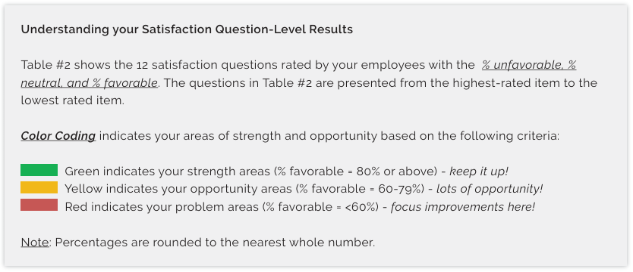
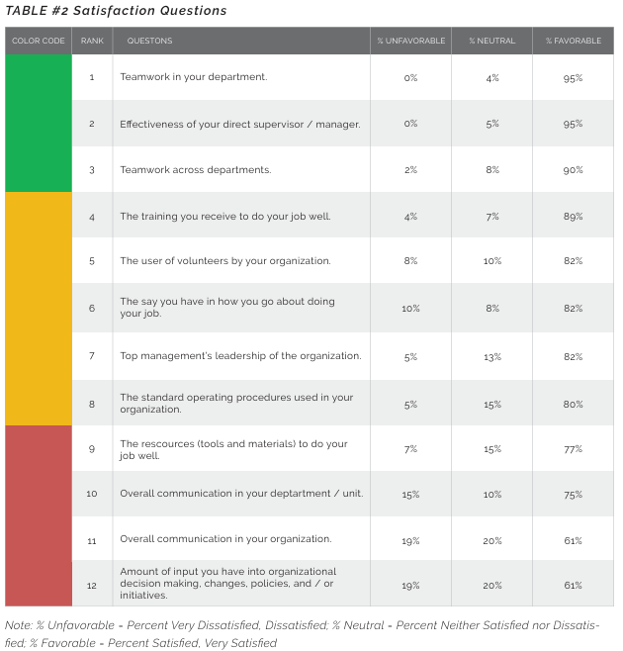
Satisfaction Question-Level Results
Satisfaction items identify specific areas where the organization can improve the employee experience.
What to look for
▪
Highest-Rated Items: Strengths to celebrate and maintain.
▪
High Neutral Scores: Areas where employees may be uncertain or divided.
▪
Lowest-Rated Items: Areas where dissatisfaction is more visible. likely priorities for action.
Look beyond any single item and consider the pattern across the table!
▪
Clusters of Green, Yellow, or Red:
Signs of potentially connected themes and experiences.
Notes:
The satisfaction results help us move from the broad Engagement Index to the specific parts of the employee experience that may be contributing to that overall score.
The table presents all 12 satisfaction questions from the highest-rated item at the top to the lowest-rated item at the bottom. This gives us a quick sense of what employees view most positively and where the organization may need to focus more attention.
Each question is also assigned a color based on its percentage of favorable responses. Green indicates a strength area, meaning that 80 percent or more of respondents reported being satisfied or very satisfied. Yellow indicates an opportunity area, with favorable responses between 60 and 79 percent. Red indicates a problem area, meaning that fewer than 60 percent of respondents gave a favorable response.
These colors are intended to help prioritize attention, but they should not be interpreted too rigidly. A yellow result does not necessarily mean that something is going badly. It means there is meaningful room to make the employee experience more consistently positive. A red result deserves closer attention, but it should be treated as a signal to learn more—not as proof that we already understand the entire problem. We may need to talk with employees, consider the organizational context, and determine which changes are realistic.
Green results are equally valuable. They identify practices or conditions that appear to be working well. These are strengths to celebrate, maintain, and potentially use as models for improving lower-rated areas.
As we review the table, we want to look beyond the color of any single question and examine the broader pattern. Start with the highest-rated questions and ask what the organization may already be doing that contributes to those positive experiences. Then examine the lowest-rated questions, particularly red items and questions near the lower end of the yellow range.
It is also helpful to look for clusters of related results. For example, lower ratings for communication within departments, communication across the organization, and employee input may all point to a broader need for more consistent and two-way communication.
Within each question, the favorable, neutral, and unfavorable percentages give us additional detail. Favorable responses represent employees who were satisfied or very satisfied. Neutral responses represent employees who were neither satisfied nor dissatisfied. A high neutral percentage may suggest uncertainty, inconsistent experiences, or an area where current practices are not creating a clearly positive experience. Unfavorable responses represent employees who were dissatisfied or very dissatisfied and may indicate a more active concern.
This distinction matters because two questions can have the same favorable score but very different response patterns. One may have many neutral responses and relatively few dissatisfied employees, while another may have a much larger unfavorable group. The second result may deserve more immediate attention, even though the favorable percentages are identical.
Ultimately, the goal is not to chase every score that is not green. The goal is to identify where improvement is most needed, where meaningful action is possible, and which strengths should continue to be supported.

Slide 9
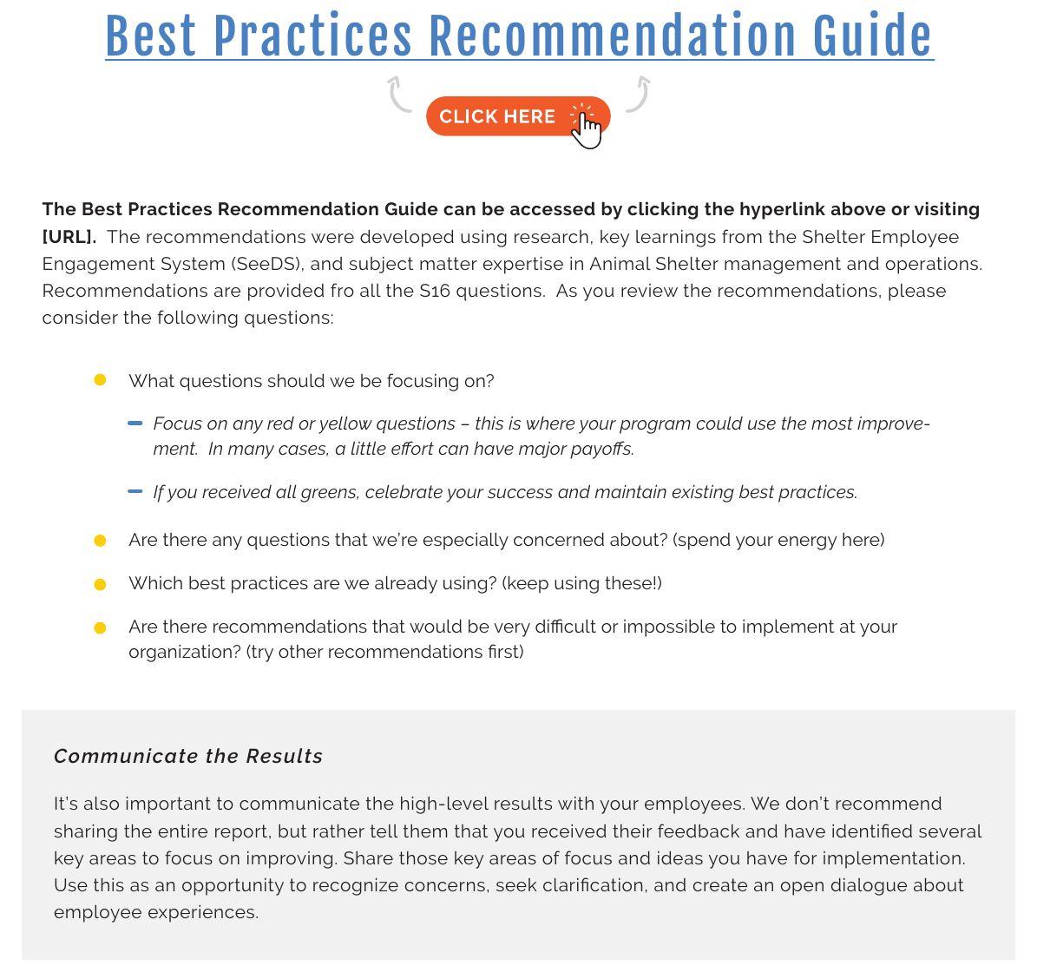
Using the Best Practices Recommendation Guide
Move from results to an intentional number of obtainable, meaningful improvements!
How to use the guide
▪
Access the Best Practices Recommendation Guide!
▪
Recommendations were developed using research, SeeDS learnings, and animal shelter management and operations expertise.
▪
Focus first on clusters of red or yellow results - this is where improvement is most needed.
▪
If all results are green, celebrate success and maintain existing best practices.
▪
Identify which best practices you already use and keep using them.
▪
Choose realistic recommendations before taking on harder changes.
▪
Communicate high-level results and selected focus areas to employees.
Do not over-extend by trying to fix everything at once.
Notes:
Once we understand the results, the next step is to decide what to do with them.
The Best Practices Recommendation Guide can be accessed through the hyperlink in the report or by visiting the listed website. It includes recommendations corresponding to all of the S16 questions.
The recommendations were developed using research, lessons from SeeDS, and subject-matter expertise in animal shelter management and operations.
Begin with the red and yellow questions. These are the areas where improvement is most likely to be needed.
That does not mean that every red or yellow item must be addressed immediately. Ask which results are most concerning, which issues affect the greatest number of employees, and where the organization has the ability to make a meaningful change.
Also identify which recommended practices are already in place. Those practices may need to be maintained, strengthened, or used more consistently rather than replaced.
Some recommendations may be difficult, costly, or unrealistic for a particular organization. It is perfectly reasonable to begin with other recommendations that are more feasible.
Try to select only a few priorities at a time. Taking on too much can overwhelm leaders and employees and make it less likely that any change will be sustained.
After selecting priorities, communicate the high-level findings to employees. Employees should know that their feedback was received, which areas the organization plans to address, and what the next steps will be.
It is generally not necessary to distribute the entire report. Instead, share the major strengths, the selected areas for improvement, and the actions leadership is considering.
Finally, remember that improvement takes time. Implement the selected practices, monitor how they are working, ask employees for feedback, and build on the progress over time.

